Slide 1
DataSpark
Power BI & My SQL

Slide 2
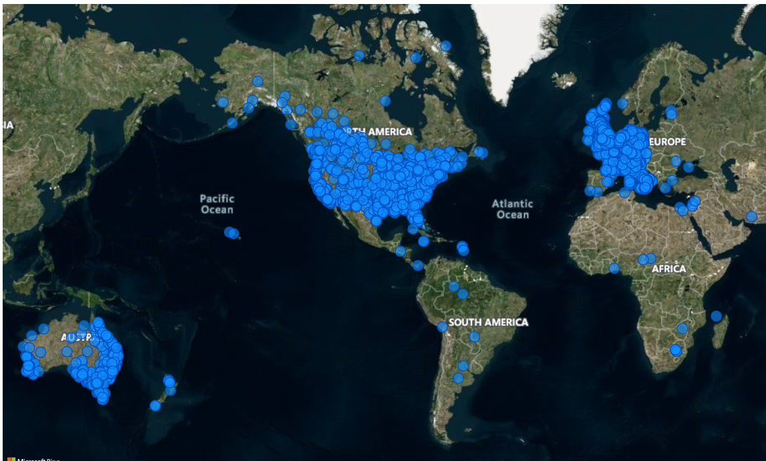
Customers spread across countries
﻿ ﻿﻿Most of sales and customers are spread in North America.﻿﻿ ﻿

Slide 3
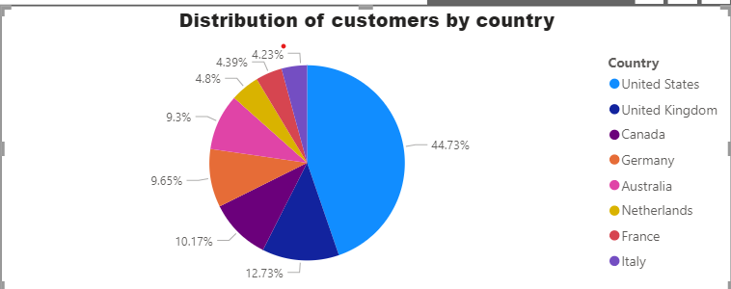
Customers across countries
United States accounted for 44.73% of Count of Customers.
UK accounts around second largest country for business.

Slide 4
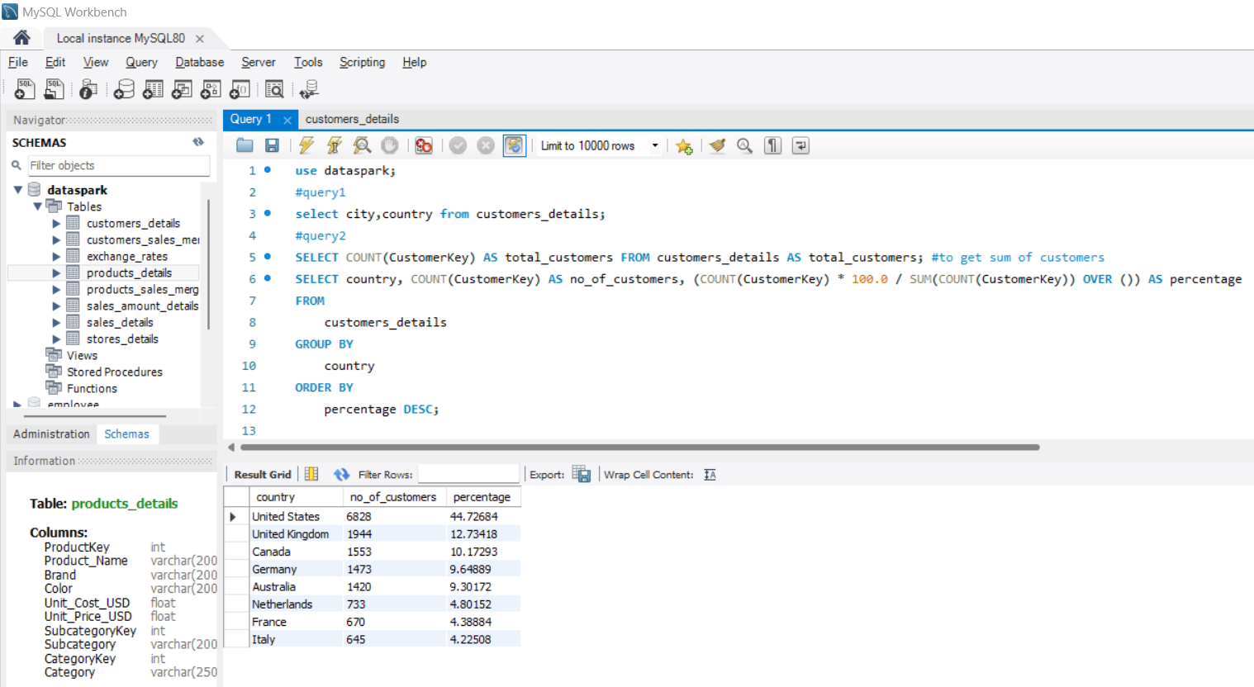
Customers across countries-SQL query

Slide 5
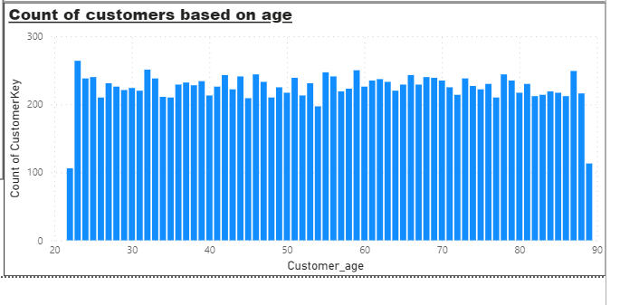
Distribution of customers in different age
﻿At 264 customers count is highest, aged 23
It is 149.06% higher than customers aged 22, which had the lowest Count of Customers of 106.﻿﻿ ﻿﻿ ﻿﻿
23 had the highest Count of Customers of 264, followed by 32 and 59.
﻿﻿Across all age groups Customers aged 68had count ranged from 106 to 264.﻿﻿ ﻿﻿ ﻿

Slide 6
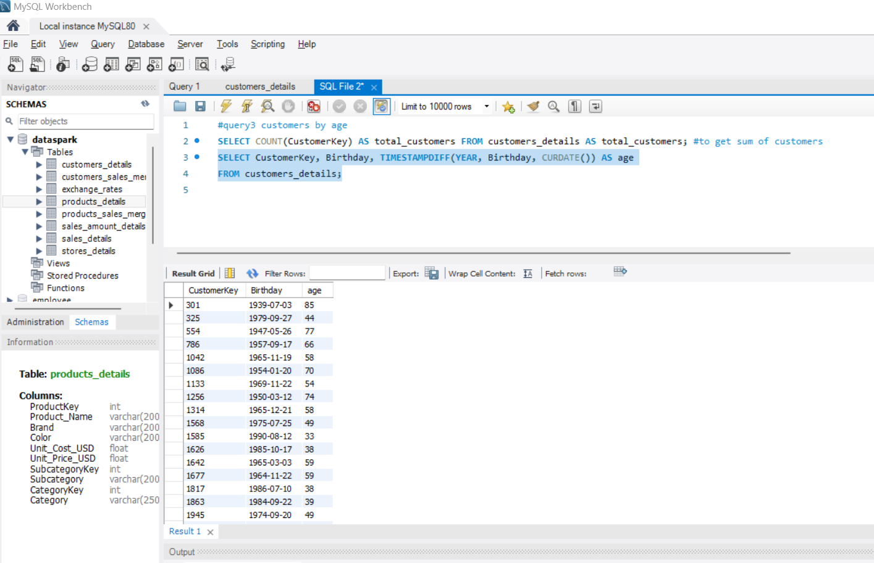
Age calculation from Birthday

Slide 7
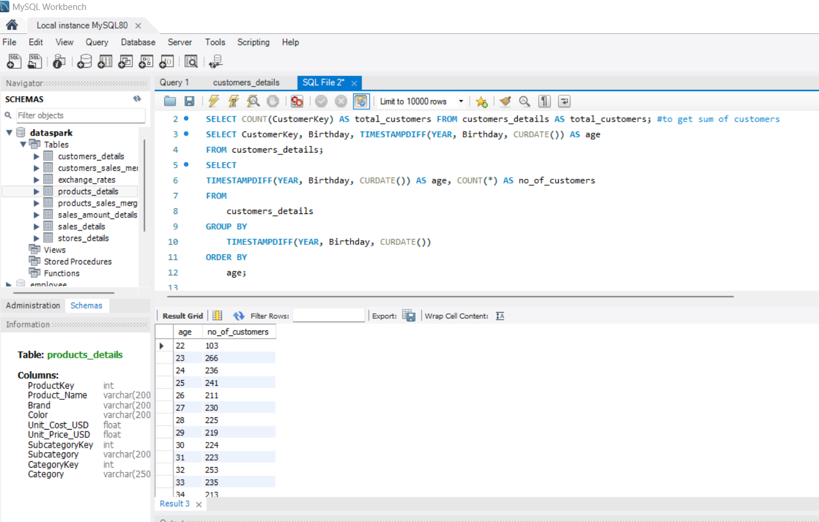
No of customers by age- SQl query

Slide 8
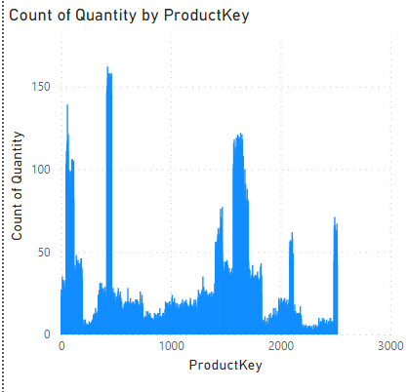
Count of product quantity for each products key
﻿ ﻿﻿Product key 423 had the highest Count of Quantity at 162, followed by product keys 458 and 446, which tied for second at 158 count of quantity.﻿﻿
﻿423 accounted for 0.26% of Count of Quantity.
﻿Across all 2,492 ProductKey, Count of Quantity ranged from 1 to 162. ﻿﻿ ﻿

Slide 9
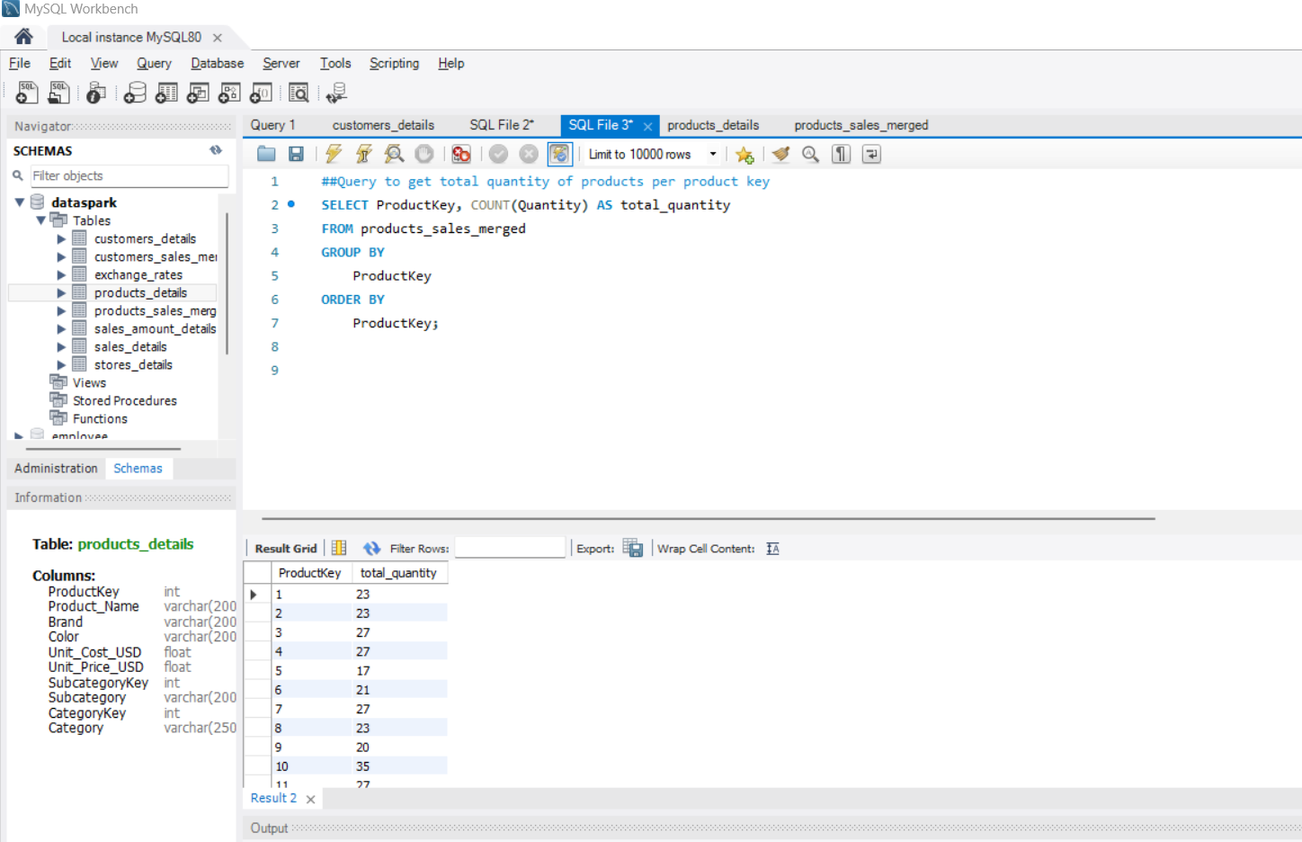
Count of product quantity for each products key – sql query

Slide 10
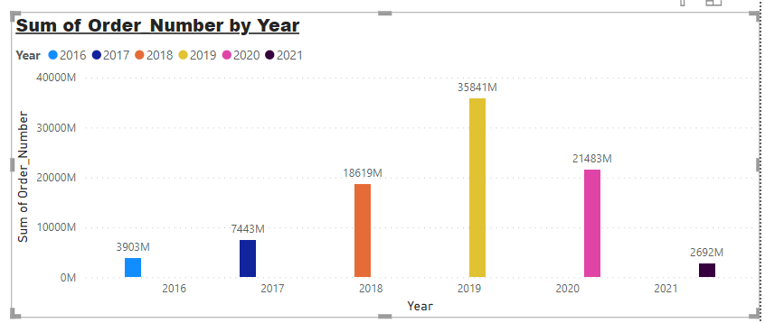
Orders by year
﻿Sum of Orders trended down, resulting in a 31.03% decrease between 2016 and 2021.
Highest orders were in year 2019 and least in 2021.

Slide 11
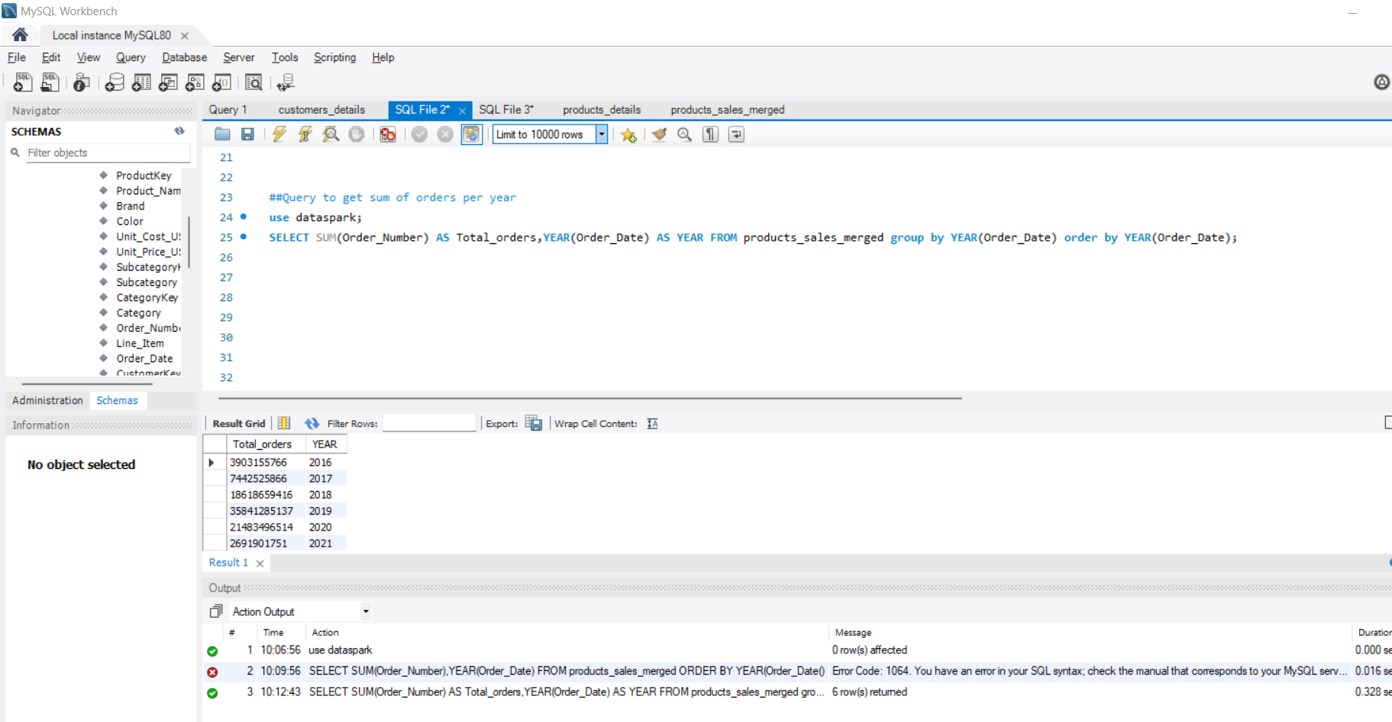
Orders by year-sql query

Slide 12
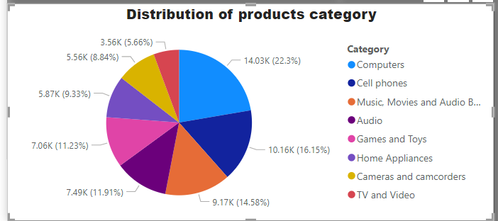
Category distribution
﻿Computers accounted highest for 22.30% of Count of Category.
5.66%, the least category count is for TV and video

Slide 13
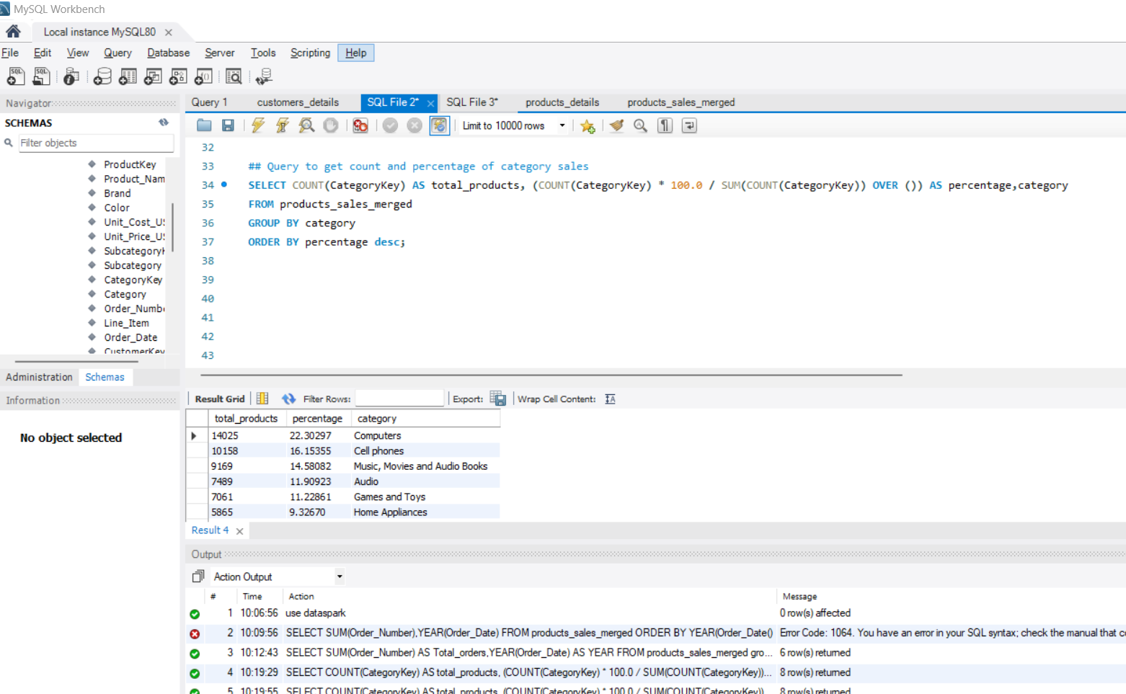
Category distribution – sql query

Slide 14
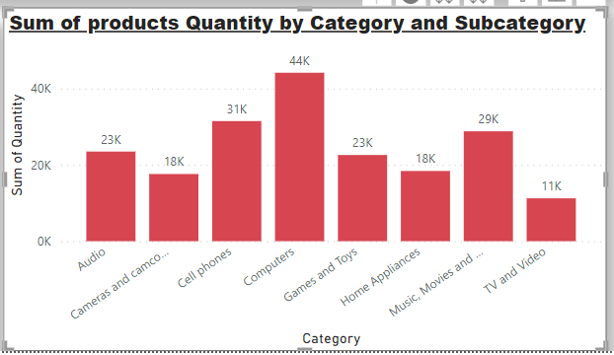
Sum of quantity by category and subcategory
Computers category gives highest quantity for sales of 44K
TV and Videos being lowest
Cell phones are second in quantity sold
Cameras and home appliances gives equal sum of quantity of 18K

Slide 15
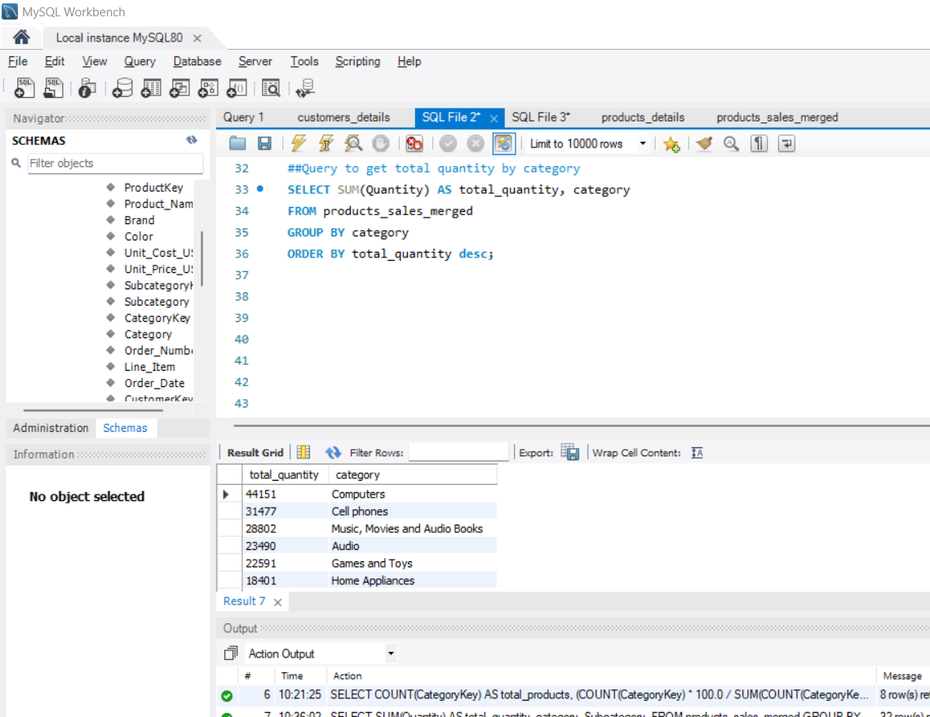
Sum of quantity by category

Slide 16
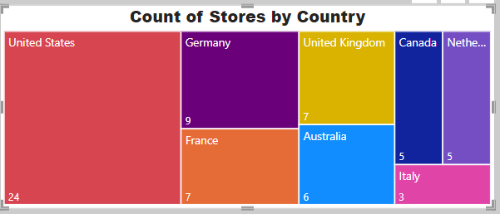
Distribution of stores across countries
Stores are distributed across 8 countries
United States has most number of stores located.
Italy has least number of stores of 3 in count

Slide 17
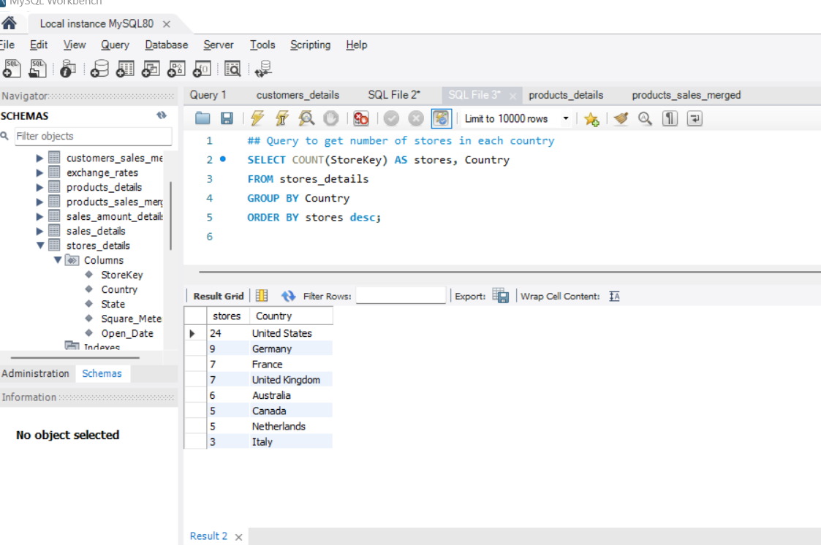
Distribution of stores across countries- sql query

Slide 18
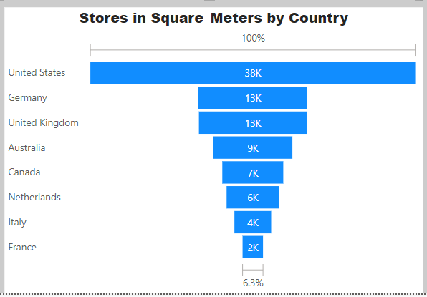
Size of stores in square metres by country
Stores in US are total around 38K sq.m in space.
France accounts 2K sq.m in space

Slide 19
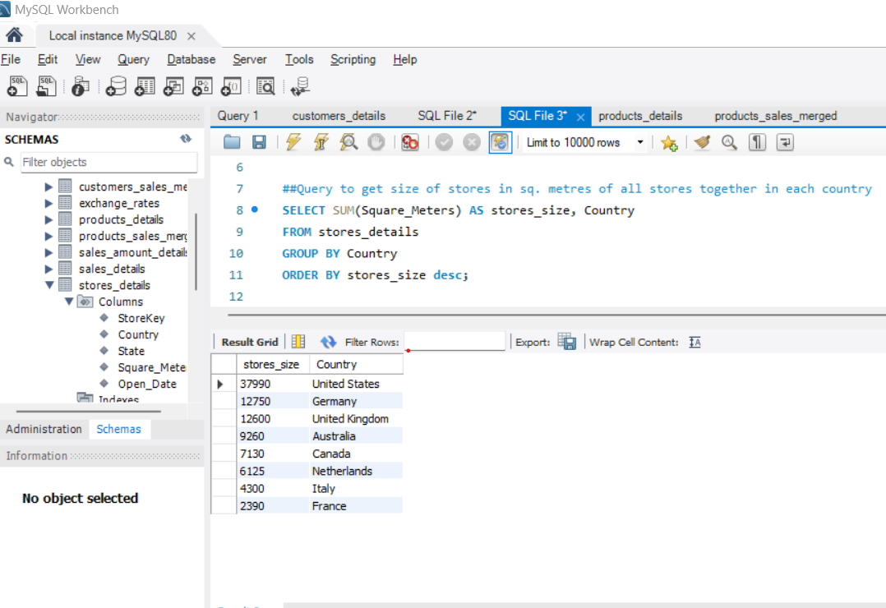
Size of stores in square metres by country- sql query

Slide 20
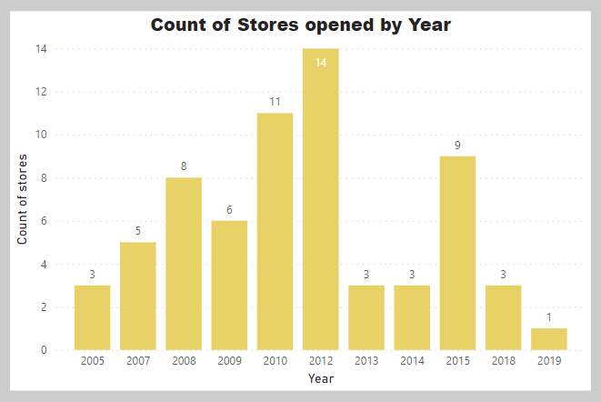
Stores opened by year
﻿Count of Stores opened trended down, resulting in a 66.67% decrease between 2005 and 2019.
﻿Count of Stores started trending down on 2014, falling by 66.67% (2) in 5 years.
Count of Stores opened dropped from 3 to 1 during its steepest decline between 2014 and 2019.
Maximum number of stores were opened in the year 2012.

Slide 21
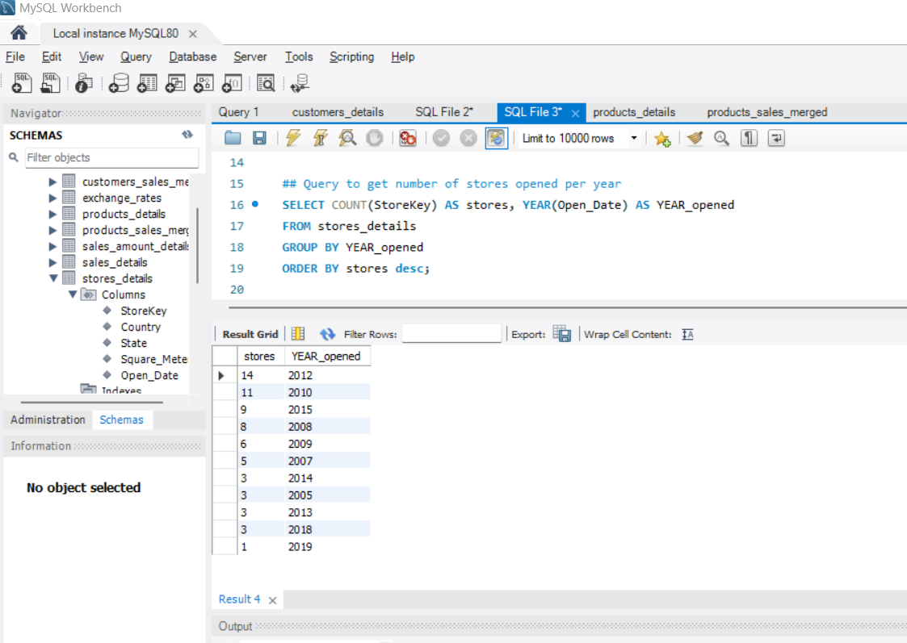
Stores opened by year –sql query

Slide 22
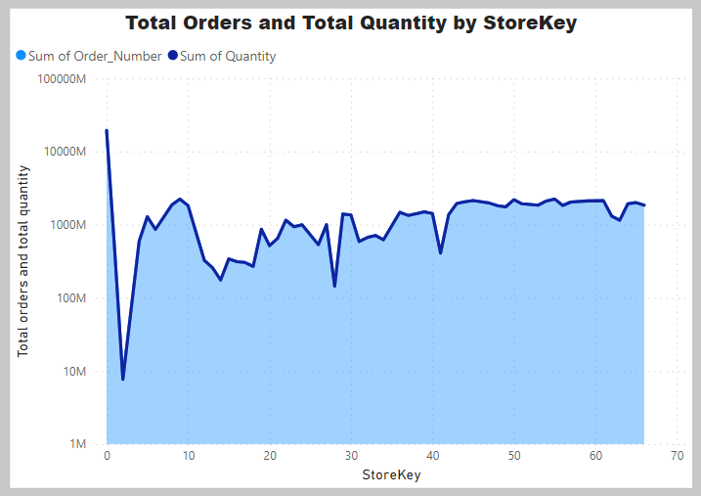
Total orders and quantity by store
﻿At 19394182536, hstore key 0 had the highest orders.
Store key 2 had lowest Orders at 7690104.﻿﻿ ﻿﻿ ﻿﻿
Total Orders and total Quantity are positively correlated with each other.﻿﻿
Store key﻿﻿ ﻿﻿0 accounted for 21.55% of total orders.﻿﻿ ﻿﻿

Slide 23
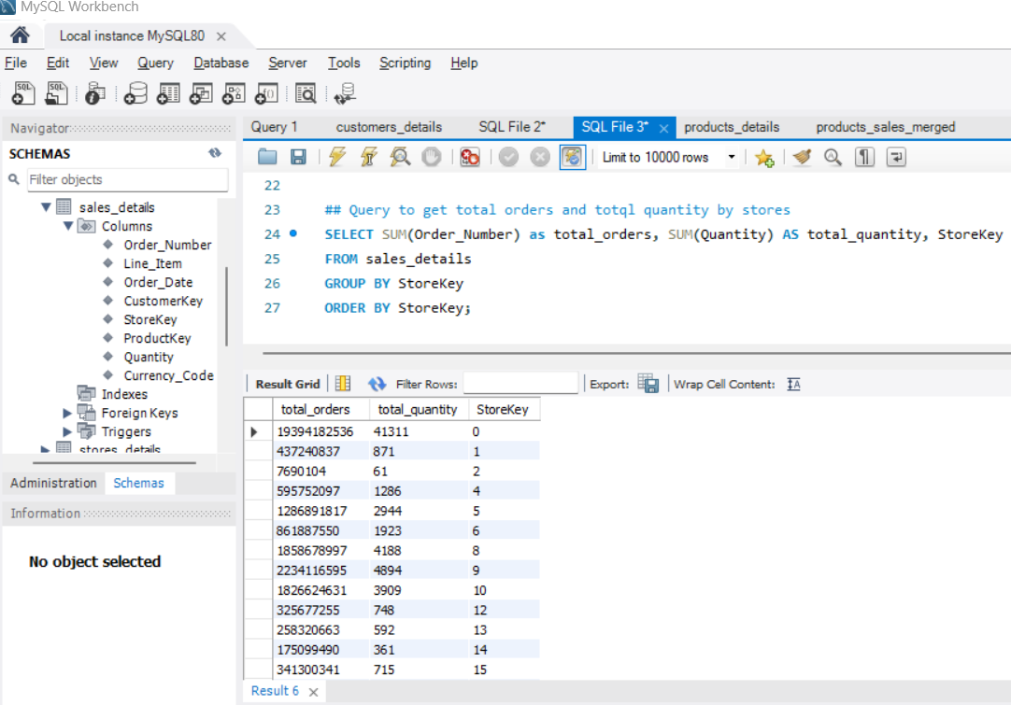
Total orders and quantity by store-sql query

Slide 24
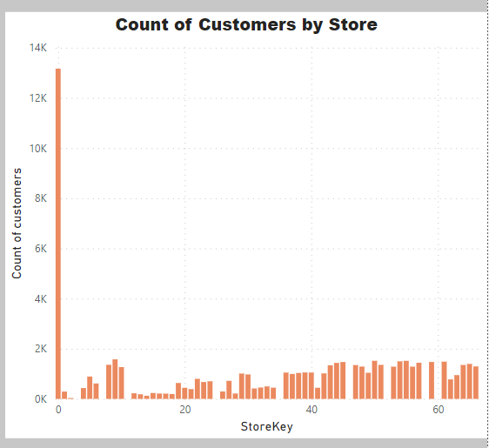
Count of customers by store
At 13,165, store key 0 had the highest Count of Customers
Store key 2 had the lowest Count of Customers at 18.﻿﻿ ﻿﻿
Store key ﻿﻿0 accounted for 20.94% of Count of Customers.﻿
﻿ ﻿﻿Across all 58 Stores, Count of Customers ranged from 18 to 13,165.
﻿﻿ ﻿﻿ ﻿

Slide 25
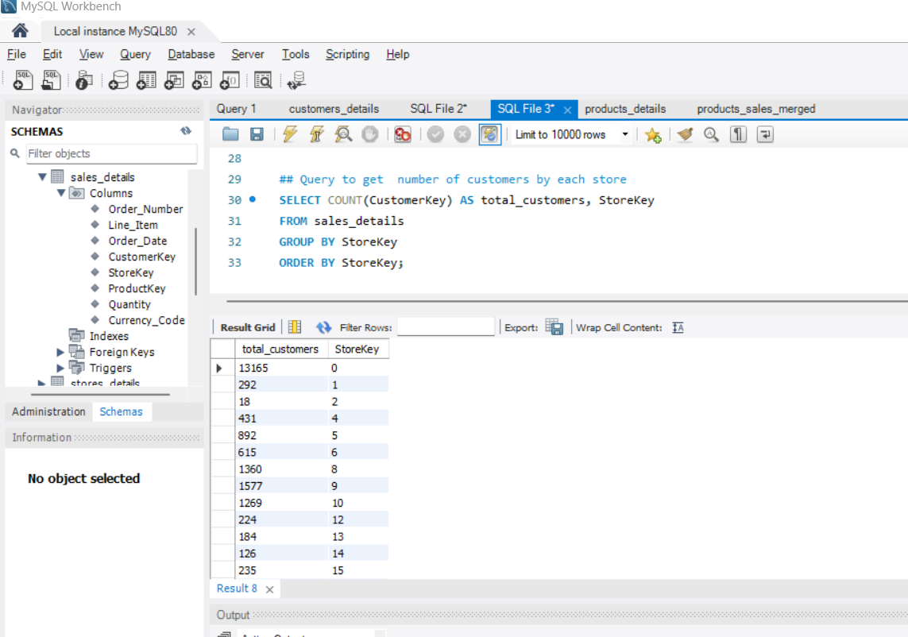
Count of customers by store-sql query

Slide 26
REPOrt
United States hold maximum number of customers and most stores locations.
2019 is the year with maximum sales but down the years sales is decreased.
Computers and its subcategories should be given most priority as its sales are the maximum and between the customers aged 20 to 25.
Second category place is for cell phones.

Slide 27
Reference:
GitHub:
https://github.com/Greeshma-G-Nair-1001/DataSpark-Project2

Slide 28
Thank you
Presented By
Greeshma G Nair

